Slide 1
Automatic Generation of Automated Test Suites
Rye Howard-Stone
CSE 5095: AI for Software Engineering
https://github.com/rhowardstone/atsr (in progress)
Feel free to follow along (this PPTX included in GitHub)
Notes:
Welcome, everyone. This is Automatic Generation of Automated Test Suites. My name is Rye Howard Stone. Feel free to follow along on our GitHub. The link is listed right there, I’ll give you a minute to copy it down if you like. This PowerPoint is actually included in the GitHub along with all of the other code for my project so far.

Slide 2
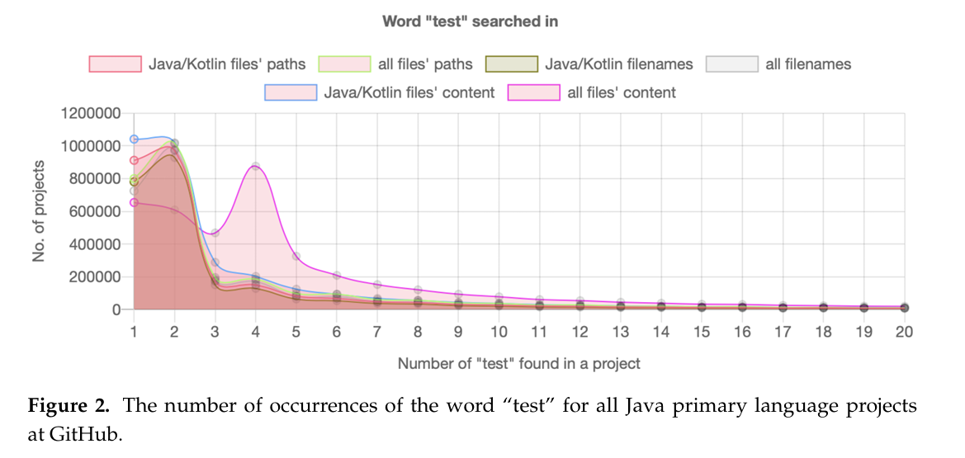
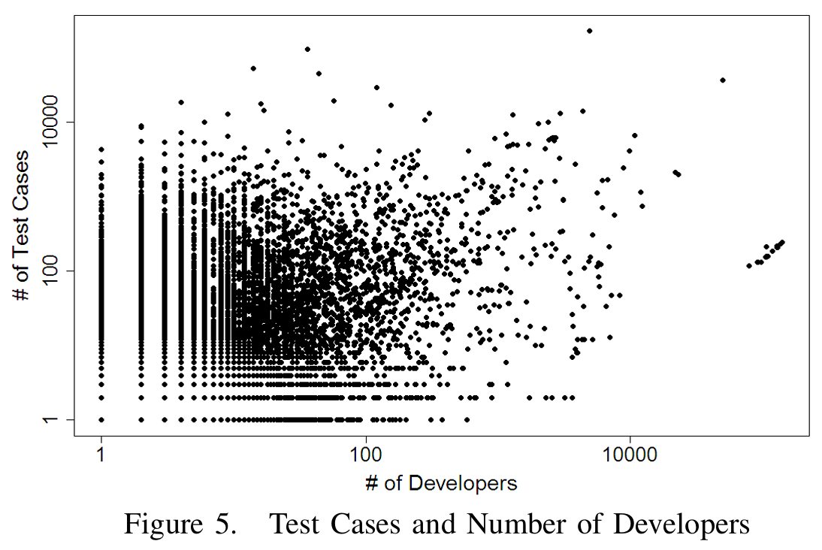
Problem: Test Suites are Incomplete
Empirical Study of Test Case and Test Framework Presence in Public Projects on GitHub
Adoption of Software Testing in Open Source Projects--A Preliminary Study on 50,000 Projects
Only 52% of 6.3M public GitHub projects contain at least one test case.
56.81% of 50K open source GitHub projects that do have test cases have only 1-9 tests.
Notes:
So the problem? Test suites are incomplete for the most part. On the left you can see a figure 2 from this empirical study where they were searching the word test in all of the Java files in a project and they're able to find that the number of test occurrences drops radically after maybe 3 or 4 and that about half of GitHub repositories have no test cases. On the right you can see a scatter plot from a different publication where it shows the number of developers on a log scale on the x-axis and on the y-axis it's log scale of the number of test cases. And you can see there's not a whole lot of correlation between the number of developers that you have and the number of test cases that you end up with. They also found that something like 60% of the projects they looked at that did have test cases only had maybe 1 to 9 tests.

Slide 3
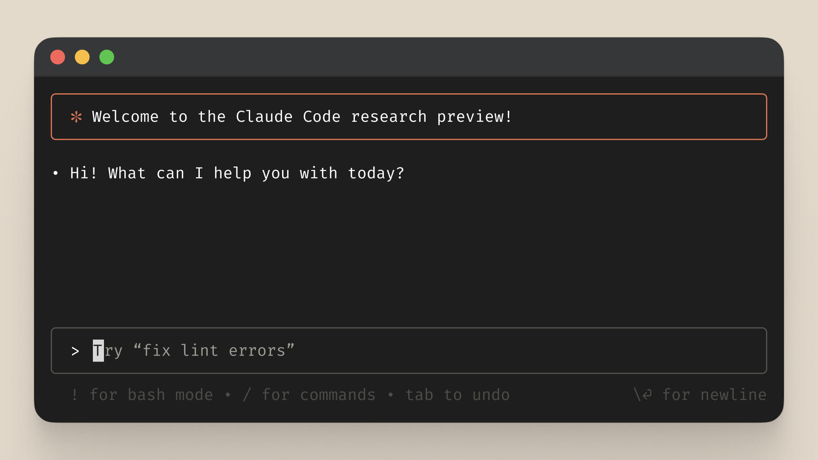
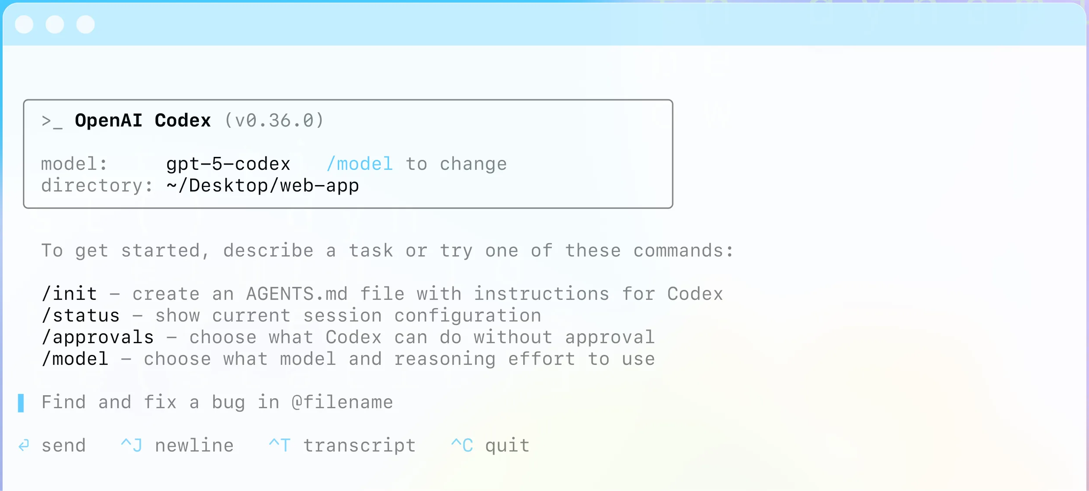
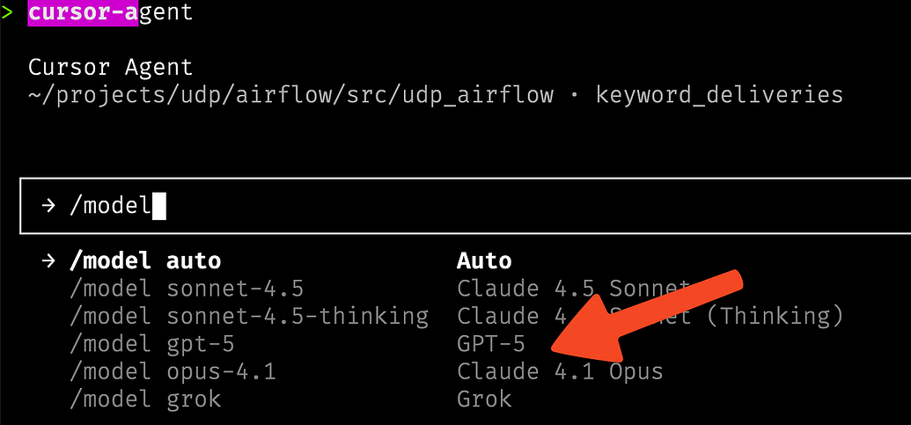
Solution: AI Coding Agents
LLM models are already capable of autonomous operations on any directory for sustained time.
Codex, Claude-Code
Cursor
Notes:
Coming to the rescue, as it is coming to the rescue of many other things nowadays, AI coding agents. There are now publicly available automated computer assistants from most major AI companies. OpenAI has Codex, Anthropic has Claude Code, and Cursor, of course, allows you to use a number of different models through the same low subscription cost. Now, these already essentially do what we need. We just need to prompt it correctly. And that's what my project is.

Slide 4
The Question
Can we improve upon existing state-of-the-art agentic coding tools’ test suite refinement abilities using hooks and slash commands*? (RQ1)
Does tool-specific guidance improve performance? If so, which tools? (RQ1A)
Are there robust methods by which agents can cut down on token usage while utilizing these tools? (RQ1B)
* ‘Slash commands’ = automated prompt macros; ‘Hooks’ = tool usage pre- or post-intercepts
Notes:
So my project, we're going to be looking at essentially one major research question with several parts. So I'm trying to see whether or not one can improve upon the existing state-of-the-art agentic coding tools test suite refinement abilities using their built-in hooks and slash commands.
So a hook is essentially something that intercepts a tool, like a bash command, before or after you do it. And a slash command is essentially an automated prompt macro. More on that later.
The two sub-questions that I'm trying to answer here are, does tool-specific guidance improve performance, and if so, which tools? And B, are there robust methods by which agents can cut down on token usage while utilizing these tools?

Slide 5
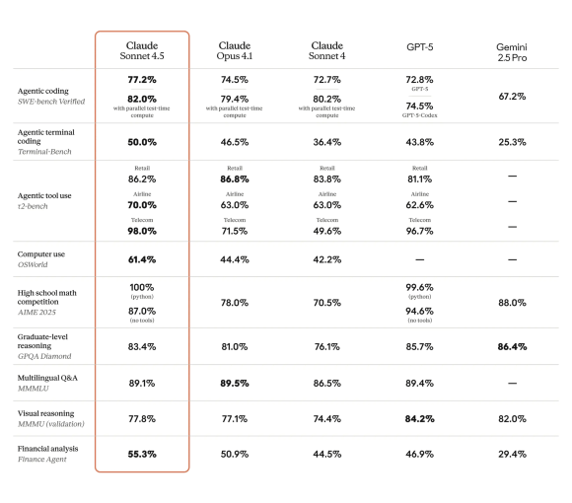

Methodology
Claude models consistently outperform comparable models from other sources on agentic coding tasks.
Claude is SoA; Sonnet 4.5 newest kid on block
I happen to have a Max subscription.
Claude Sonnet 4.5 vs GPT-5 vs Claude Opus 4.1 – Ultimate Coding Comparison – Bind AI IDE
Notes:
I had to decide upon a base model to use. I could have tested a few, but the more I do, the more expensive it gets, and the tools are not necessarily comparable between products. So you can see here a mainly coding benchmark among most popular recent models, Claude, GPT, and Gemini, and Claude models consistently outperform comparable models from other sources on agentic coding tasks like this. Most of the people in this room can probably attest to Claude's proficiency in coding. Claude is certainly state-of-the-art, nonetheless, even if you don't think it's the best out there, and Sonnet 4.5 is probably the newest major model that has been released. I also happen to have a Claude Max subscription, so it's no additional expense for me to test these things.

Slide 6
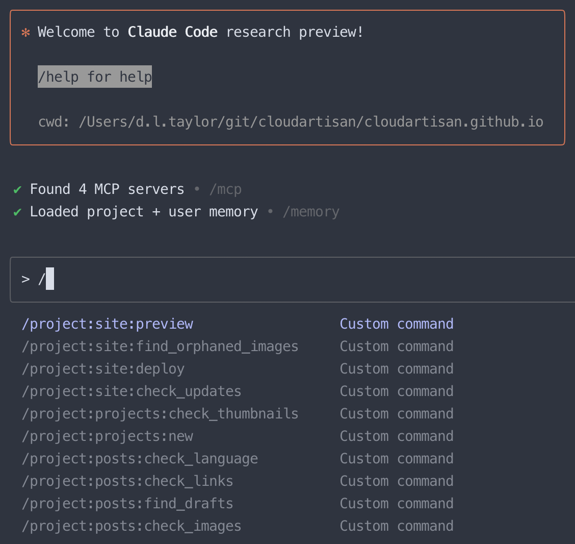
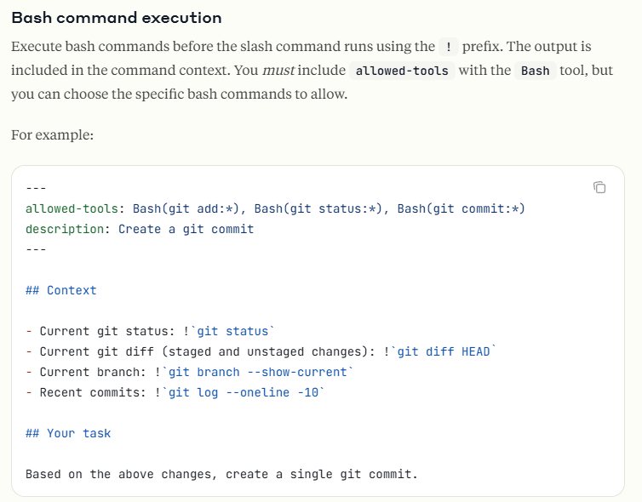
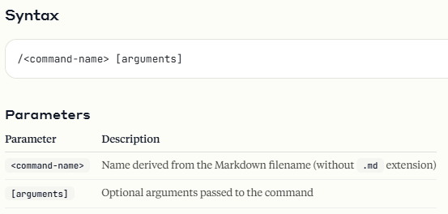
Methodology - Background
Slash commands:
Slash commands - Claude Docs
Notes:
A little background on slash commands. If you've used Cursor or Claude Code or Codex, you've seen them. You type backslash and then any number of predefined commands come up that the creators of Cloud have put in there, and you can also actually create your own. And they have a number of different interesting features, so that the general syntax is given there below. You just type backslash the command name, and then you can give it arguments. And then inside you can actually execute bash commands. Now I think of this as more of a token saving tool for the purposes of this project you'll see in a moment, but an alternative approach might actually *run* specific bash commands to add the output as context to Claude when it's fed the slash command. You can see a simple example of this here, where a slash command runs a few git commands, then directs the model to act upon those outputs.

Slide 7
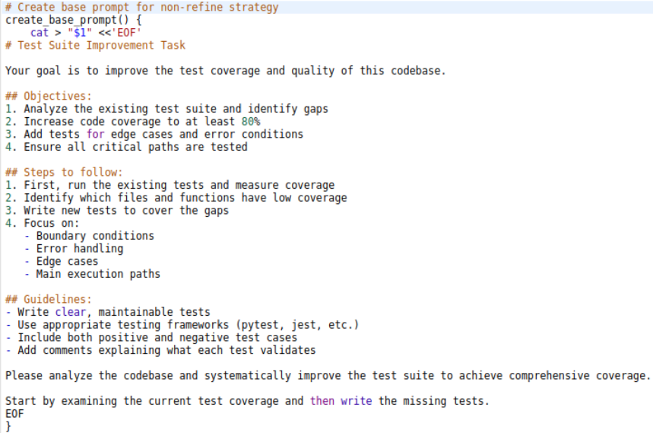
Methodology – Base Prompt
Simple prompt against which to compare our slash command:
The full slash command, refine-tests.md, is essentially just a (much) more complicated version of this.
Notes:
Now, of course, we need something to compare *against*, and here’s what I decided upon. This is the base prompt that I use to compare the full slash command. As you can see, it just gives basic directions, essentially just telling the model to examine coverage and write tests to meet gaps in coverage. The full slash command that you'll see in a moment is essentially just a much more complicated version of this. I did not yet incorporate running bash commands into my slash command.

Slide 8

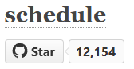



Methodology – Executed
Obtained 3 Python repos with test suites:
Repos w/ reduced test cases (~50% coverage)
Removed tests until ~50% coverage
Two strategies:
Base
/refine-tests
Measuring:
Coverage
Pass Rate
Number of tests
Tests/Mtokens
(4 AI agents)
Base x Opus | Refine x Opus
Base x Sonnet | Refine x Sonnet
Opus 4.1
Two models:
Sonnet 4.5
DEMO (6:22)
Notes:
And here's a full diagram of the methodology that I've managed to execute so far this semester. I obtained three Python repos with extensive test suites, click, mistune, and schedule. I then removed tests and any trace of them until we reached about 50% coverage for all three repos. I then test four different AI agents, the four combinations of the two models, Opus 4.1 and Sonnet 4.5, with our two strategies, our base prompt and our refine tests slash command. So those four combinations, base cross Opus, refine cross Opus, base cross Sonnet, refine cross Sonnet. I test all of those on each of the three reduced test coverage repos. And then measure a bunch of different things. Coverage, pass rate, number of tests, test per million tokens. And here's a demo that I can show you that will explain a little bit more.

Slide 9
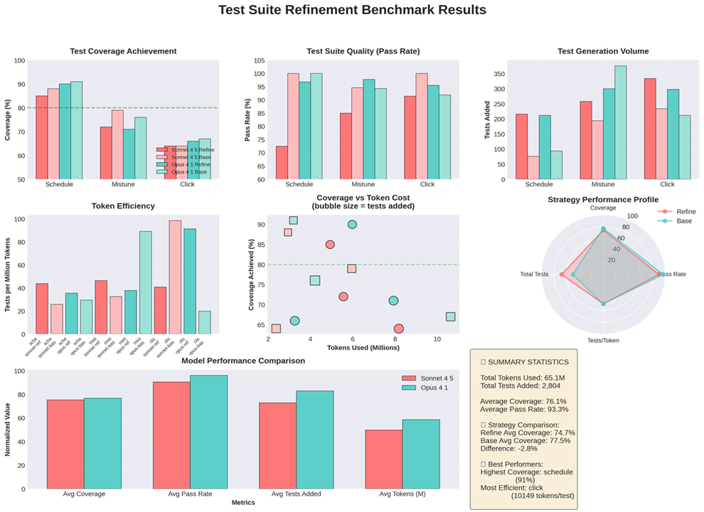


Preliminary Results
Negative result!
Base model does better!
Refinement command not effective as written.
Sonnet - Refine
Sonnet - Base
Opus - Refine
Opus - Base
Notes:
Okay, and as you can see, unfortunately, so far, my result is a negative one. So the base model actually does better. The refinement command is not effective as written. It exceeds the performance of the base models a little bit in some cases. You can see the refined models are these darker colors. The red and blue. The lighter red and lighter blue are the two base models. And you can see there really isn't a consistent pattern as to one doing better than the other. You can see in Mistune, it actually looks like we had the reverse. The base was significantly better than refined. In Schedule, we actually see the same thing. In Qlik, it looks like base and refined for Sonnet did about as well in terms of final test coverage. There's, of course, the test suite quality. The total number of tests generated, of course, was more for the refined model, but fewer of them passed. So you can see the test per token is about on par. So we really didn't do much better than just feeding a very basic prompt. However, we did set up an extensive testing framework, so future things will be easier to test.

Slide 10
Refining the refiner
What’s done:
Test data obtained (3 python repos)
Test suites reduced to ~50% coverage
Evaluation framework written and tested
Refinement slash command drafted
Preliminary results on draft inconclusive
Can we improve upon existing state-of-the-art agentic coding tools’ test suite refinement abilities using hooks and slash commands? (RQ1)
Does tool-specific guidance improve performance? If so, which tools? (RQ1A)
Are there robust methods by which agents can cut down on token usage while utilizing these tools? (RQ1B)
x
x
x
Roadblock:
Testing variants is expensive.
Each comparison run takes about 30-50% of weekly usage.
Questions:
Do you see any flaws in my approach or evaluation?
How would you improve from here?
What would you try next?
How would you limit token usage?
Any expert test suite refinement advice?
Any expert Claude usage advice?
Prospective Goals:
Test simpler versions, one tool type at a time.
Study base model performance to reveal optimization opportunities.
Notes:
I've shown my research questions again up here on the left. Unfortunately, we have yet to check off a single one. Okay, so essentially what I've managed to do so far in the three or so weeks I've been working on this is obtain the three Python repos, reduce their coverage to 50%, and set up a fairly comprehensive evaluation framework, which you can see on the GitHub, in order to test this refinement slash command, which I have drafted. But of course, my preliminary tests have shown that the results are inconclusive at best. The current roadblock is that testing variants is expensive. Each one of those runs, when I ran those four models there together, took about 30 to 50% of my weekly usage. So I can only afford to do maybe one or two of them a week. So that's the main bottleneck, at least. My goals till the end of the semester are to test simpler versions, not an ablation study, but in fact, getting some kind of refinement command that works. Perhaps breaking it down and only giving a few tools or one tool at a time. Balancing that, of course, with my limited testing capacity because of API costs. One thing that I have not done that I would think is probably a good next step is to study the base model performance to reveal optimization opportunities. So all of the results in the previous slide are actually included on the GitHub, the exact logs of every action they took. So if I create something that allows me to diagnose those, do some forensic analysis on what worked and what didn't there, perhaps we can treat that like a form of model training. I can iterate until I get better results on that repo and then I'll have to obtain some more final test repos. So my questions here are, do you see any flaws in my approach or evaluation? How would you improve from here? What would you try next? Would you limit token usage somehow while trying to improve performance, or save that until you have something that works better than the base model? Are there any expert test suite refiners in the house or any expert Claude users that can give me some advice? What did you think in general? Thank you for coming!

